Slide 1

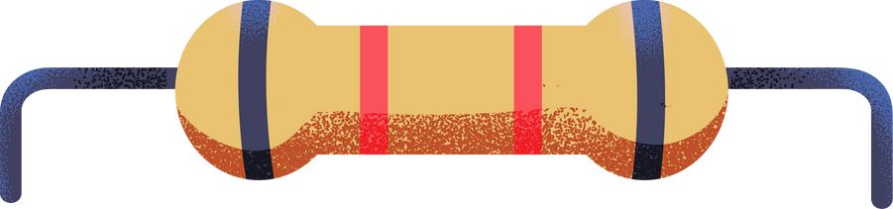

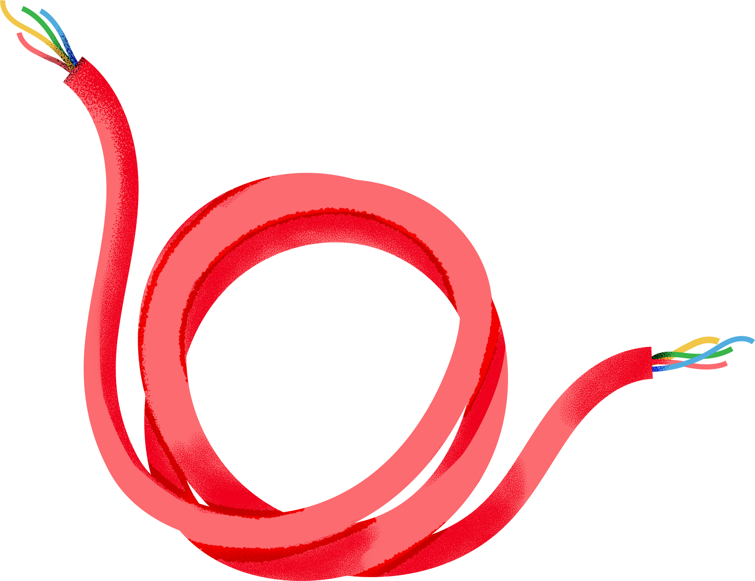

3-in-One Obstacle detecting, Line following RC Robot
Group 05
Section 09
Nafis Ashraf 21301410
Neelavro Saha 21301181
Rafi Shahriyar 21301198
Ajmain Islam 21101348
CSE461

Slide 2
Components Used
1. Gear Motor (x2)
2. Battery Pack
3. Motor Driver (L298N)
4. Infrared Sensor (x2)
5. Raspberry Pi 3.0
6. Servo motor
7. Ultrasonic Sensor
8. Powerbank
9. Wheel (x2) + Caster Wheel

Slide 3
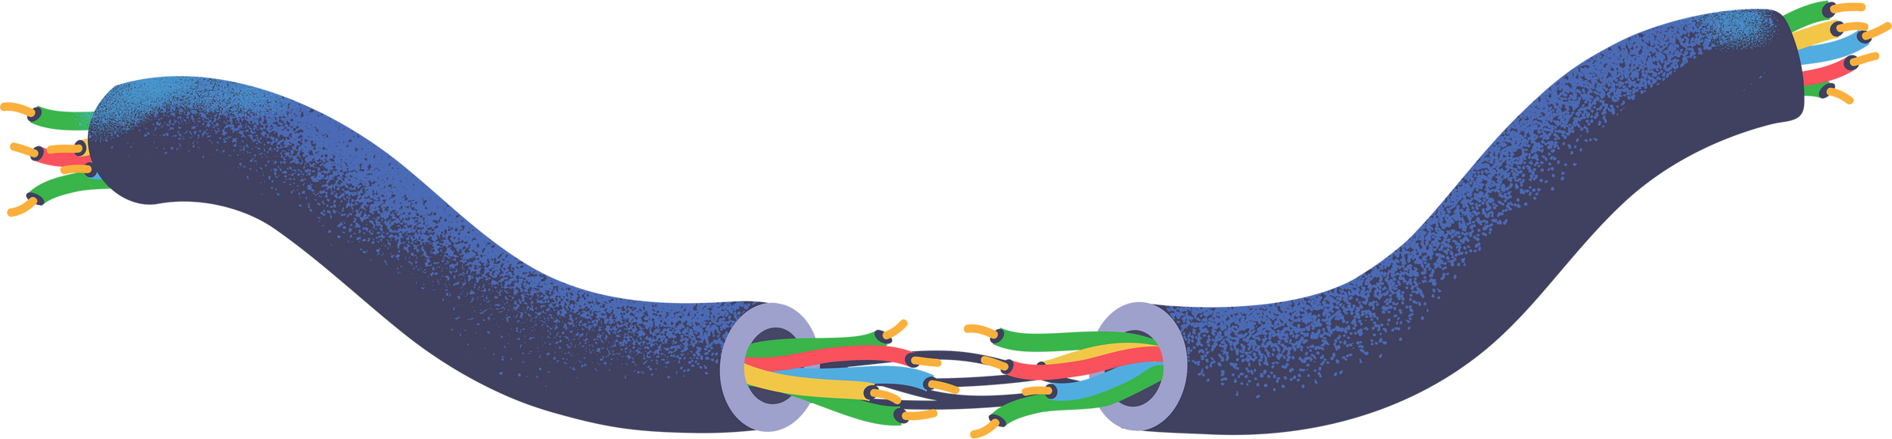
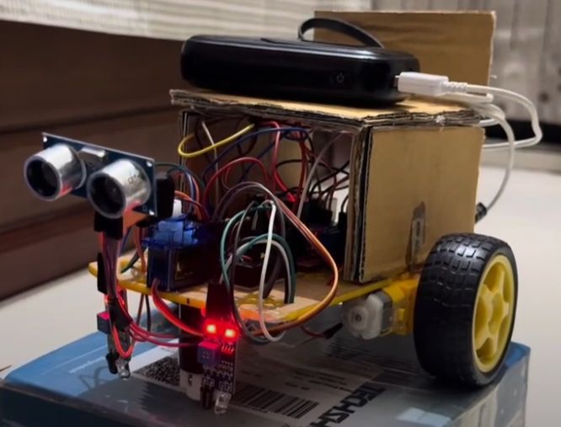
3-in-One Robot

Slide 4
Cost Breakdown
Components | Quantity | Price (TK)
Gear Motor | 2 | 170
Battery Pack | 1 | 100
Motor Driver | 1 | 195
IR Sensor | 2 | 120
Raspberry Pi 3.0 | 1 | -
Ultrasonic Sensor | 1 | 100
Power bank | 1
Car Parts (castor wheel, frame, wheels) |  | 400

Slide 5
Purpose
The 3 in one design serves as a solid foundation which in future can be streamlined to create a robot that can be used to improve human quality of life. We also found this 3 in one design very engaging and its implementation method very intuitive and interesting.

Slide 6
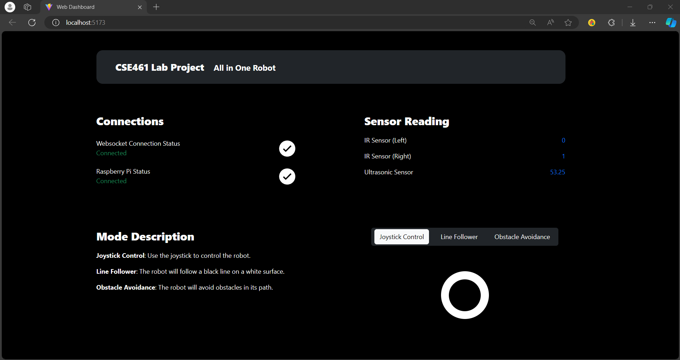
Web Dashboard

Slide 7
Web Dashboard
Framework used: React, Node, Javascript and Express.js
In order to control our robot we are using a web dashboard and to implement such control, we used the following network setup.
Firstly, in order to ensure a seamless connection between our robot and web dashboard we had to ensure that the raspberry pi and the web dashboard were connected under the same network.
Secondly, Our server, operating alongside the web dashboard on a laptop, serves as the intermediary for transmitting instructions and data between the dashboard and the robot. Commands such as "FORWARD," "BACKWARD," or mode changes originate from the web dashboard, travel through the server, and are executed by the robot.
Simultaneously, sensor data, including readings from IR and ultrasonic sensors, is transmitted from the robot to the server, then relayed back to the web dashboard for real-time monitoring

Slide 8
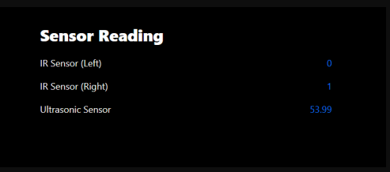
Sensor Readings
Sensor used: Infrared and Ultrasonic
The Raspberry pi sends sensor data to the server and server relays the sensor data to dashboard which is shown on server dashboard as sensor readings.

Slide 9
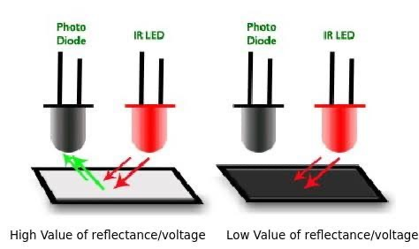
Line Following Robot
Sensor used: Infrared
Two infrared sensors are present at the front to check the position of the black tape placed on the ground. When the IR sensor is on top of white surface it gives a reading of zero contrarily on a dark surface (taped part of the ground) a reading of one is given. The main principle behind this is that the white surfaces reflects the IR rays and the black surface absorbs.

Slide 10
Line Following Robot
Line follower continued:
If left IR sensor shows a reading of 1 then robot moves left
If Right IR sensor shows a reading of 1 then robot moves right
If both IR sensors shows a reading of 0 then the robot moves straight.

Slide 11
Obstacle Detection
Sensor used: Ultrasonic
We have an ultrasonic sensor that is mounted on top of a servo motor at the front to detect obstacles. When the robot is in obstacle detection mode it is continuously gauging the distance from the present obstacles using ultrasonic sensor. If a reading of the ultrasonic sensor goes below a certain threshold (5cm) the robot stops. Then the servo rotates to 0 degrees (left) and measures the distance. Then it rotates to 180 degree (right) and measures distance again. Whichever distance is larger the robot rotates in that direction, then starts moving forward again until further obstacle is detected.

Slide 12
Joystick Control
Python library used: Socket.io
We used "react-joystick" js library in our web dashboard. Depending on the position/movement of the joystick, the web dashboard sends instructions - "FORWARD", "BACKWARD", "LEFT" or RIGHT to the server. When the joystick returns to its original position, "STOP" command is sent.

Slide 13
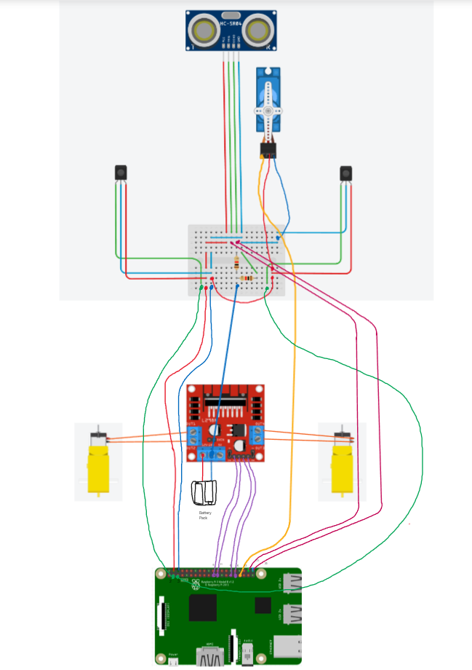
Schematic diagram

Slide 14
Hardware Design Decisions
The car outline we purchased could not fit all the hardware components so we had to create another layer above the existing components using cardboard to accommodate the remaining parts and sensors.
Infrared sensors were placed at bottom level so that they are as close to the ground as possible
Ultrasonic Sensor is mounted on the servo motor to ensure it can perform 180 degree rotation to gauge the distances between obstacles
In order to reduce design complexity we decided to use two wheels and one caster wheel to help navigate during turns

Slide 15
Challenges Faced
The chassis we bought from the store is originally designed for arduino uno. So in order to accommodate our raspberry pi along with all other components present several design changes had to be made.
Out of all the PWM pins present in the raspberry pi some were barely functional so there was a rigorous process of trial and error.
Setting up the motor driver specifically for Raspberry pi required a common ground which got overlooked by us initially as most resources from youtube and online documentation present were for arduino uno.
One of the motors were spinning slower compared to the other one

Slide 16
Thank you!

